Slide 1
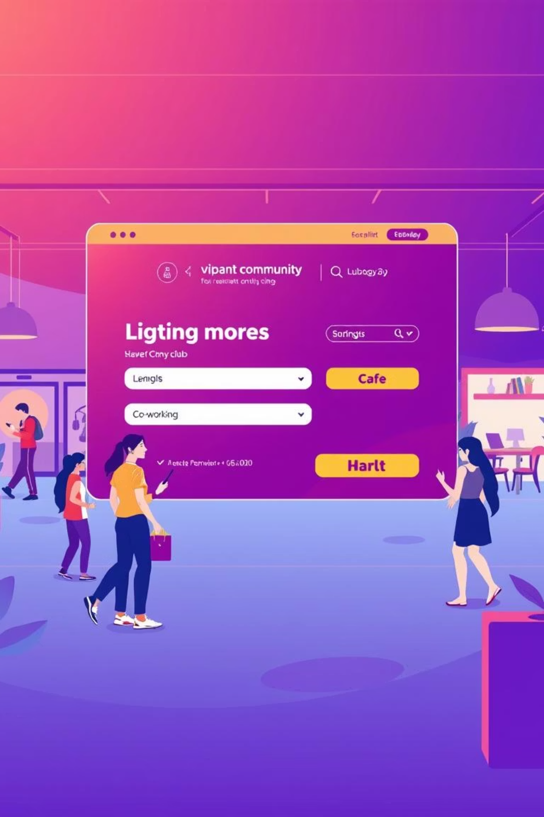
e-Booking CLAB
Optimizing Workplace Reservations

Slide 2






The Challenge: Managing Bookings in CLAB
Manual Mayhem
Demand for Digital
Asset Tracking
Double bookings, lost reservations, and overwhelming administrative tasks plague traditional systems.
Today’s staff expect 24/7 online access, easy confirmations, and modern convenience.
The lack of asset tracking features makes it harder to track previous bookings and who booked the assets

Slide 3
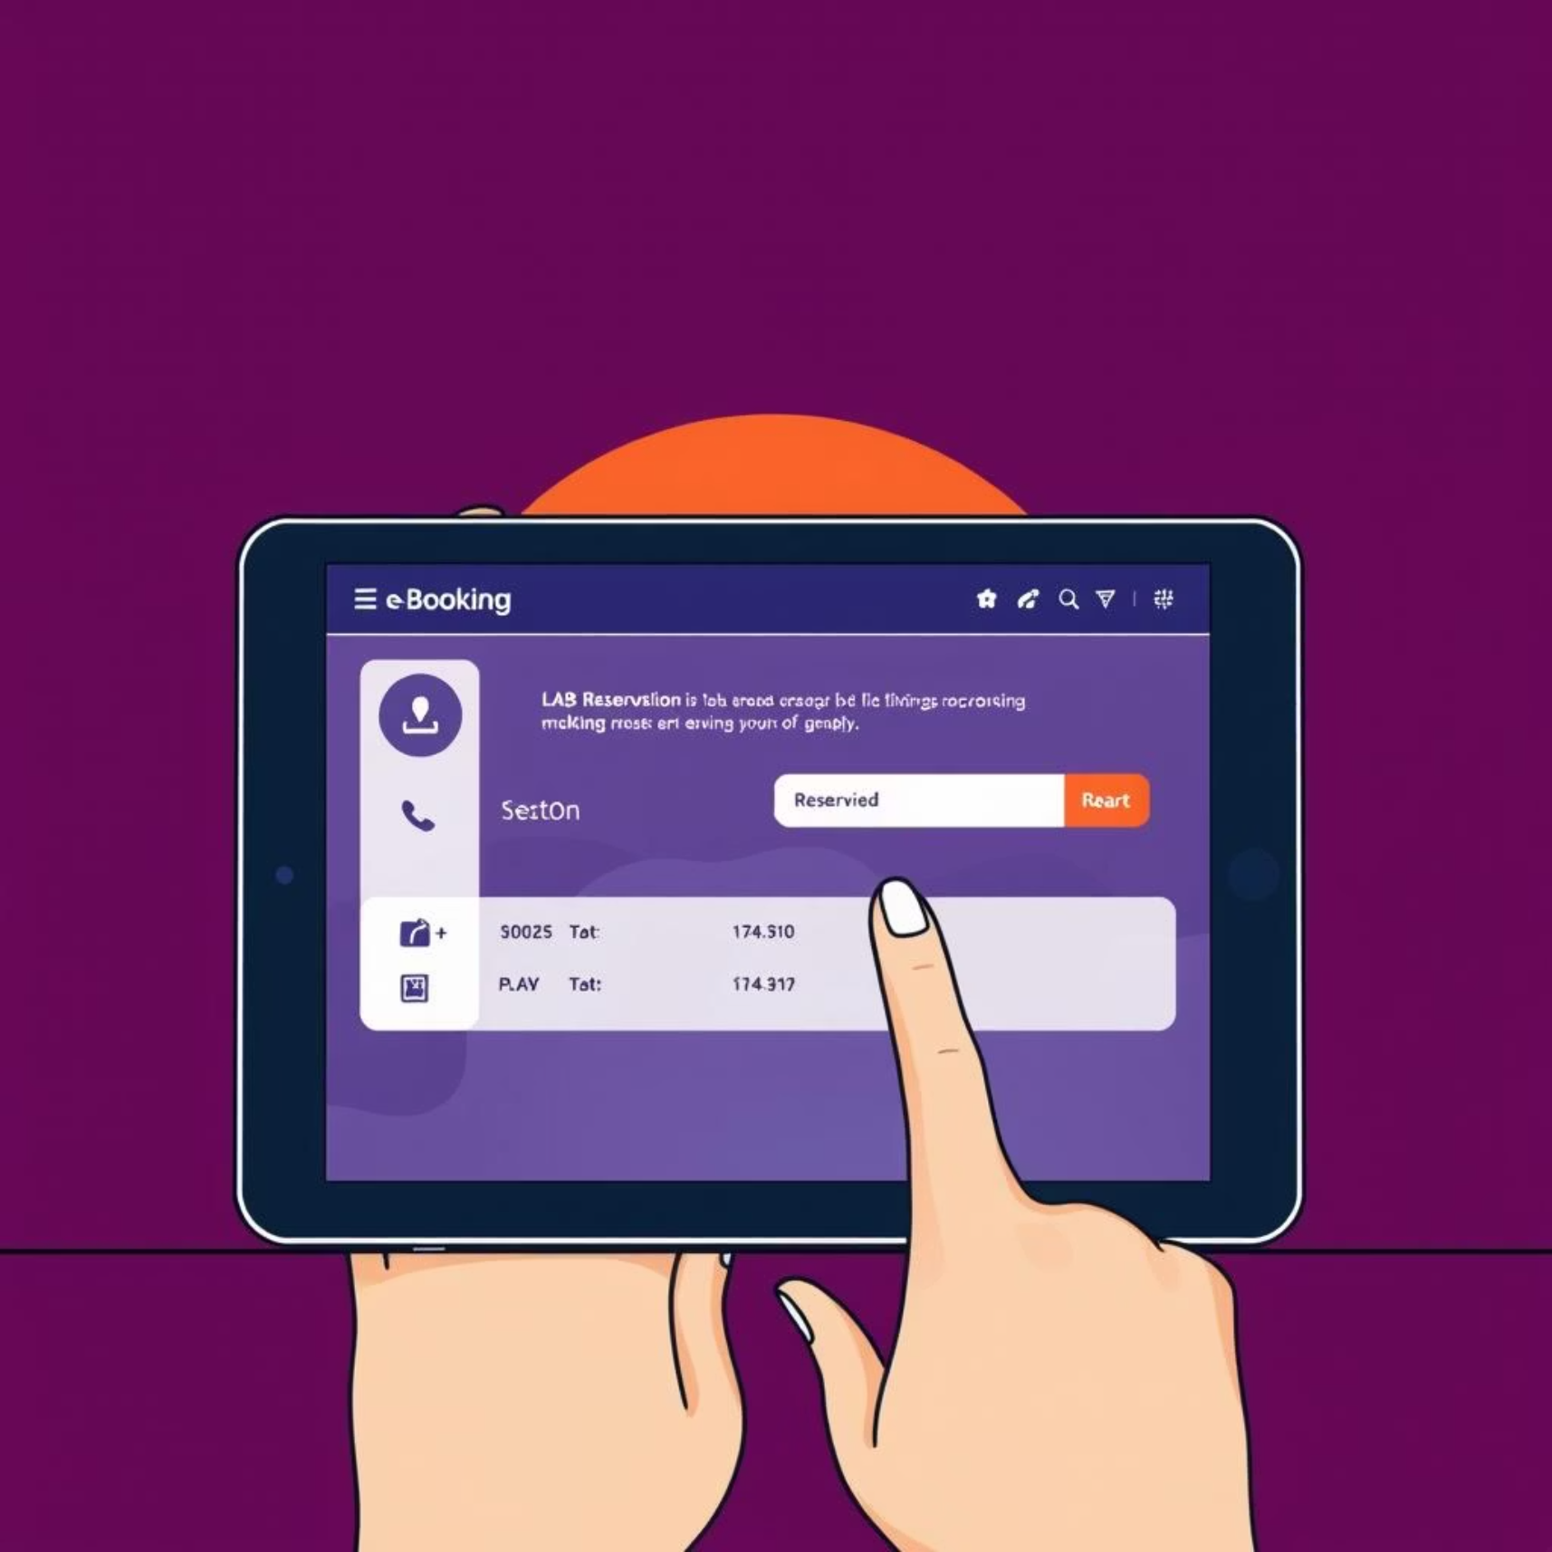
What is e-Booking CLAB?
e-Booking CLAB is an online booking system that enables staff to reserve meeting rooms, vehicles, and IT assets.
The system is owned by the Support Sector (Admin) and is overseen by the General Manager, En. Razali TC.
Meeting room and vehicle bookings are managed by the Admin Department, while the IT Department is responsible for IT assets.
Enables real-time facility availability viewing and instant reservations.
Supports membership management, event scheduling, and automated reminders.

Slide 4
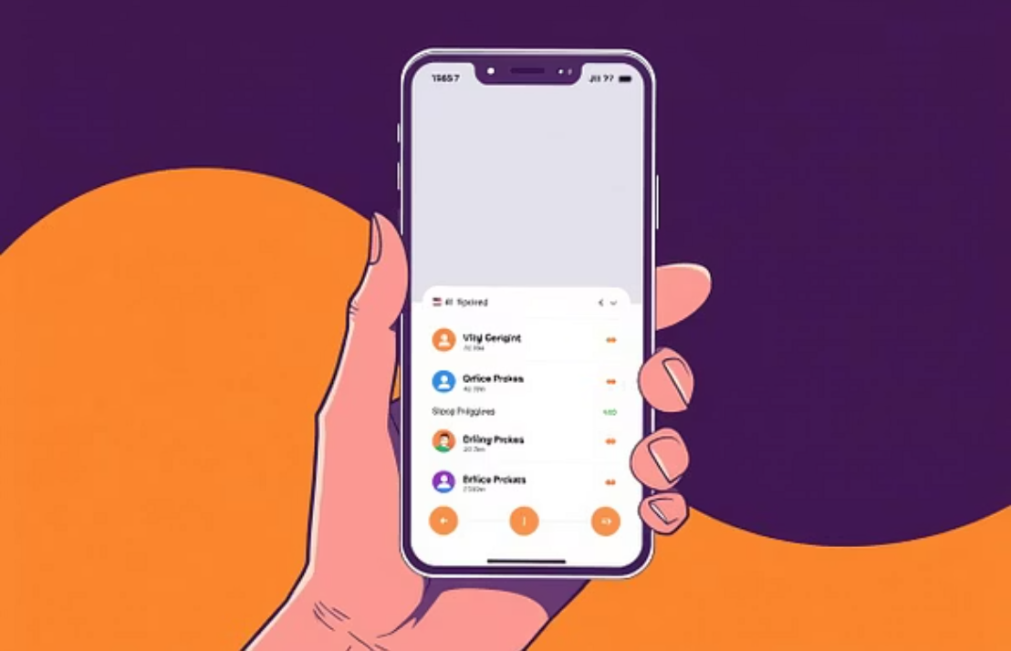


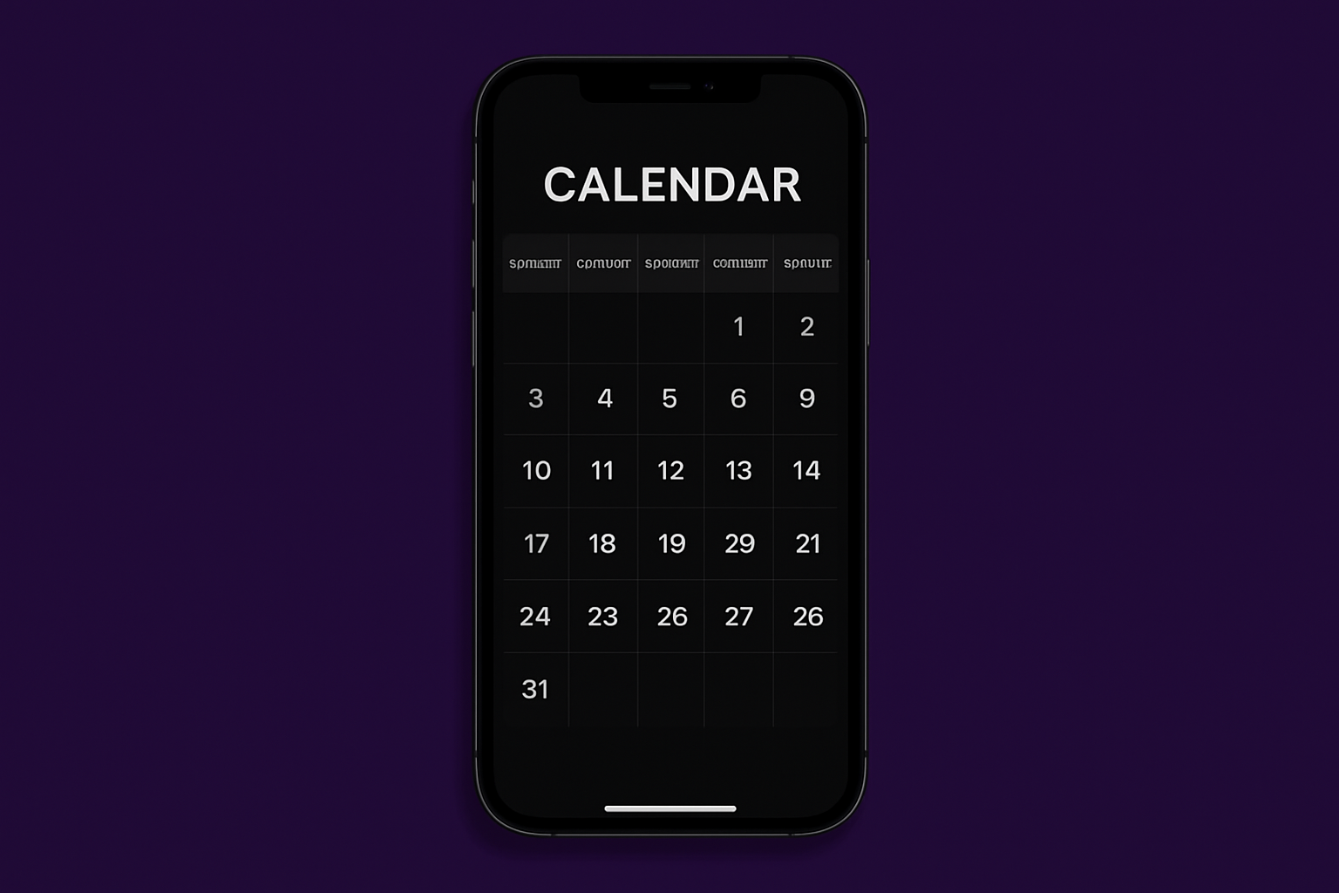
Key Features
Mobile Friendly
Dark Mode
Calendar

Slide 5
Booking System Process Flow
View Process Flow

Slide 6
e-Booking CLAB (Phase 2)
1
New Modules
2
QR Codes
More details assets management and Stationary booking
Each assets will put a unique QR code for staff to scan to mark as done booking.
3
Calendar Invitation
4
Integration with AI
Invitation with Microsoft Outlook API and Google Calendar API
Utilize AI to automate the generation of user statistics and reports, providing a more efficient way to analyze data

Slide 7
Join the e-Booking CLAB Revolution
Transform your booking process with a proven, efficient system.
Let’s Book

